Slide 1
Organizational Structure and Culture
  The structure and culture of the organization are critical success factors to the risk-management program, as they directly influence and inform staff decisions relating to risk prevention, risk detection and risk response efforts.
  A mature enterprise has policies and procedures and an effective reporting and notification structure in place to detect, notify and escalate a situation effectively.
  For instance, an enterprise that does not have a mature incident response capability will often react to incidents in an unpredictable, ad hoc reactive manner and can expect to experience inconsistent results.
  The risk management function should have an enterprise mandate (delegation) that allows risk practitioners to review and provide input into all business processes, participate in incident management activities and be responsible for reviewing incidents for lessons learned and to improve incident response planning, detection and recovery.
  If the organizational culture is to hide problems rather than communicate or address them or to only use an adverse situation to point blame then the ability of the risk practitioner to effectively contribute to the protection of the enterprise and assist in the investigation of an incident may be severely impaired.
  Figure 1.9 illustrates a sample organizational structure.

Slide 2
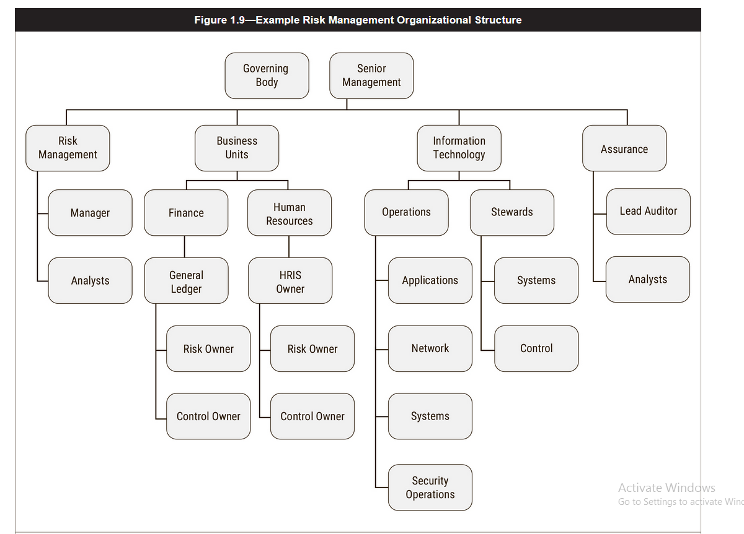

Slide 3
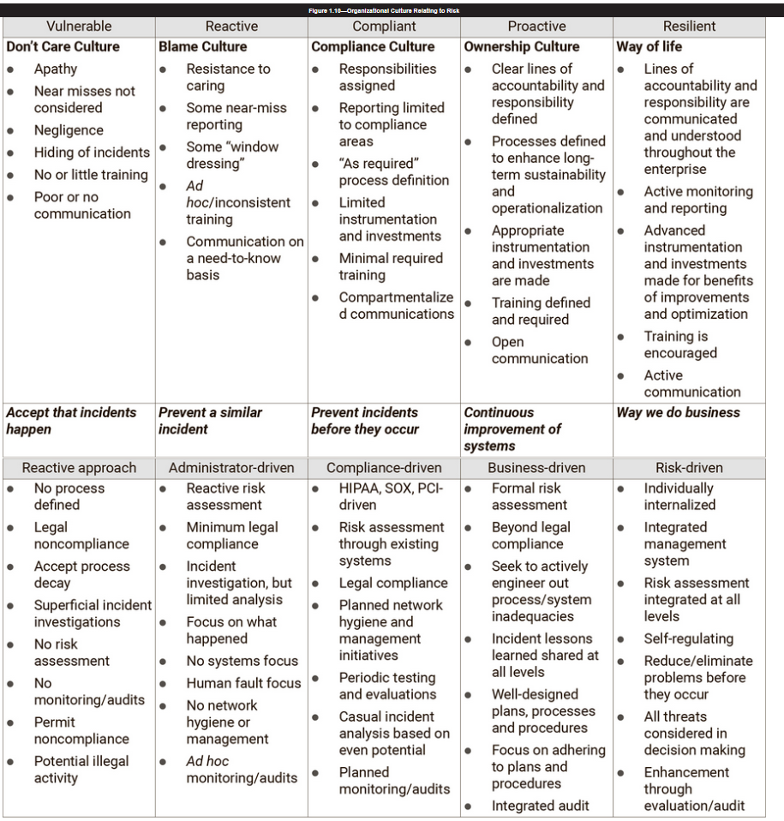
Organization
Culture
Relating
To Risk

Slide 4
Organizational Culture and Behavior and the Impact on Risk Management
  One of the first challenges faced by a risk practitioner is to determine the risk appetite of senior management.
  Examples of risk that management must evaluate and set criteria for accepting include deciding whether the enterprise should:
    Invest
    Take on a new line of business
    Develop a new product
    Open a new office
    Invest in new hardware or software
    Upgrade existing applications
    Implement new controls
  The risk practitioner should be aware that the risk appetite may change over time or vary based on the type of risk.
  Thus, the risk appetite requires periodic review. Depending on market conditions, confidence, past successes or failures, global economics, reports in the media, availability of resources, new regulations or long-term strategy.
  The need for these to be established prior to risk management efforts ensures that responses to risk are considered in the proper context.
  For one example, a business unit may establish criteria prior to kicking off a project that allows for an increase of up to 20 percent in the project duration, while at the same time only allowing for a 10 percent increase in costs.
  Another example is a financial institution that has generally defined a low appetite for credit card fraud and has implemented aggressive anti- fraud safeguards and countermeasures.

Slide 5
Risk Culture
  senior management develops and transfer a particular level of willingness to adopt, carefully accept or avoid risk; this is called the risk culture of the enterprise.
  In order to successfully embed an effective risk culture within an enterprise, senior management needs to lead from the top, supporting these concepts not only with their words, but also with their actions.
  The best indicator of the enterprise risk culture is how it makes decisions on how to best respond to various risk.
  Risk culture reflects a balance between weighing the negative, positive and regulatory elements of risk, being informed as to the direction and response relating towards taking risk
  as seen in figures 1.12 and 1.13. Symptoms of an inadequate or problematic risk culture are listed in figure 1.14.

Slide 6
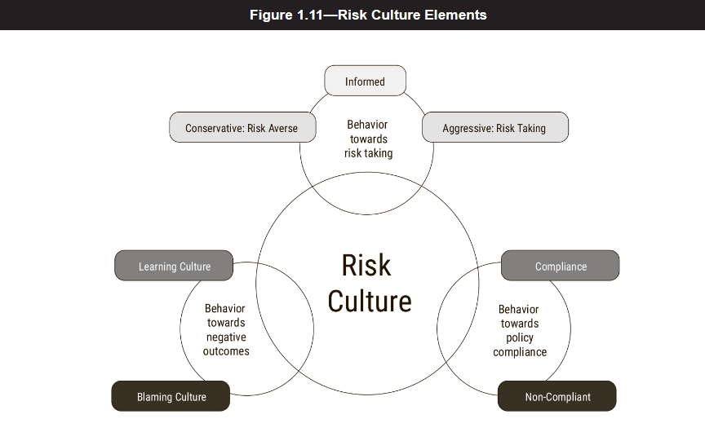
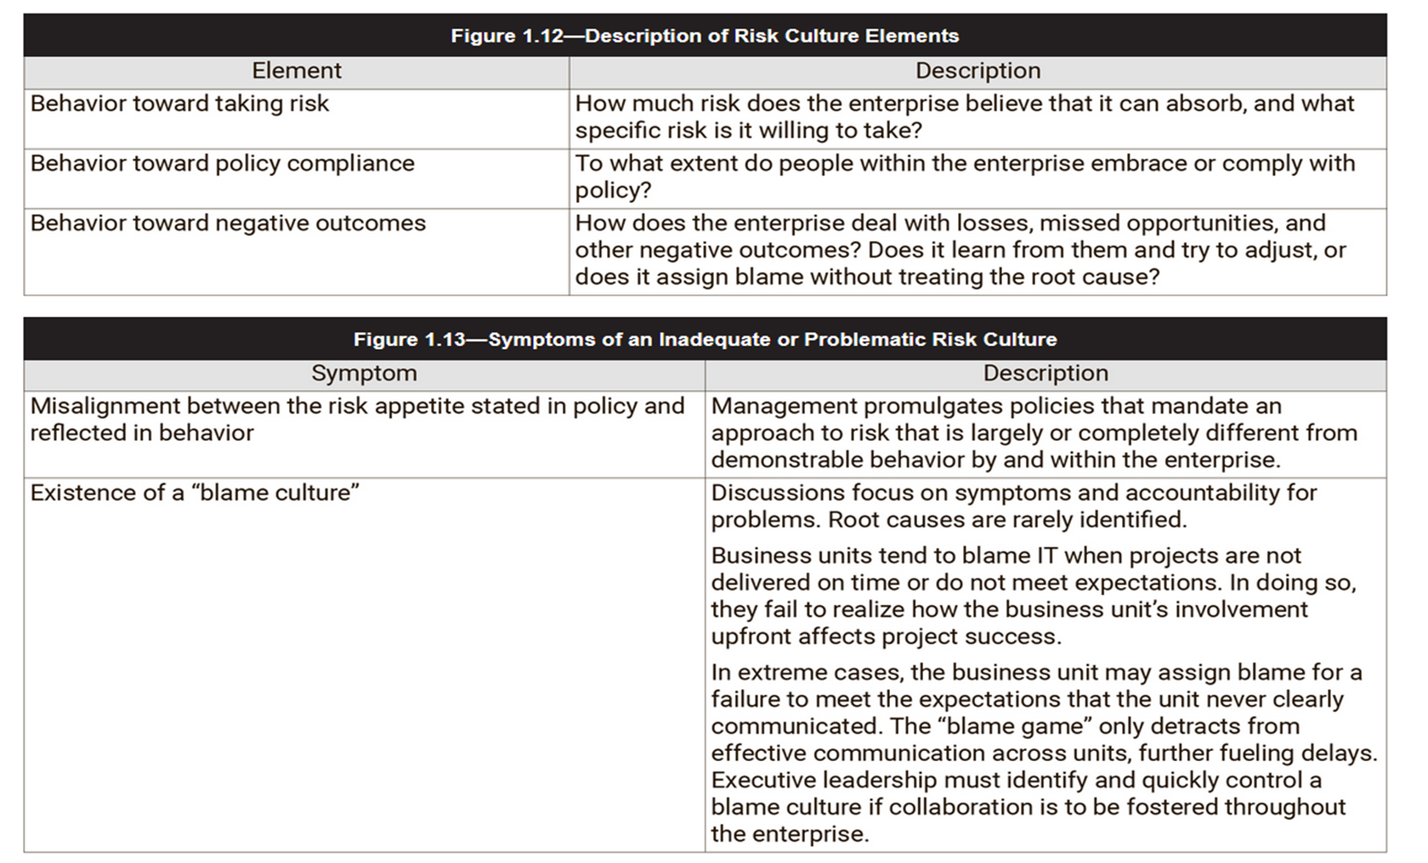

Slide 7


Slide 8
Risk Awareness
  Awareness is a powerful tool in creating the culture, forming ethics and influencing the behavior of the members of an enterprise.
  Through awareness programs, will enables employees to identify and report on risk and to work to defend systems and networks from attacks.
  They can help identify vulnerabilities, suspicious activity and possible attacks.
  This may enable a faster response and better containment of a risk when an attack happens.
  Risk awareness acknowledges that risk is an integral part of the business.
  This does not imply that all risk is to be avoided or eliminated, but rather that:
    Risk is well understood and known.
    IT risk issues are identifiable.
    The enterprise recognizes and uses the means to manage risk.
  A risk awareness program creates an understanding of risk, risk factors and the various types of risk that an enterprise faces.
  A risk awareness program should not disclose vulnerabilities or ongoing investigations except where the problem has already been addressed.

Slide 9
Using examples and descriptions of the types of attacks and compromises that other organizations have experienced can reinforce the need for diligence and caution when addressing risk.
Awareness education and training can serve to mitigate some of the biggest organizational risk and achieve the most cost-effective improvement in risk and security.
This can generally be achieved by educating an organization staff in required procedures and policy compliance, along with ensuring that staff can identify and understand the risk that threatens the organization.
It is critical that the training effectively communicate the risk and its potential impact in order for staff to understand the justification for what may be seen as inconvenient extra steps that risk mitigation and security controls often require.
Awareness of information security policies, standards and procedures by all personnel is essential to achieving effective risk management.
Employees cannot be expected to comply with policies or standards that they are not aware of, or follow procedures they do not understand.
Periodic use of a standardized testing approach provides metrics for awareness trends and training effectiveness.
Indicators for additional training requirements can come from various sources such as tracking help desk activity, operational errors, security events and audits.

Slide 10
A Risk-driven Business Approach
mature organization is one that is able to make informed decisions relating to the various risk, in its respective business context.
This means that the risk practitioner is able to carry out risk management efforts that aligns with the defined risk appetite.
Figure 1.14 describes a sample approach for assessing risk associated with data loss.

Slide 11
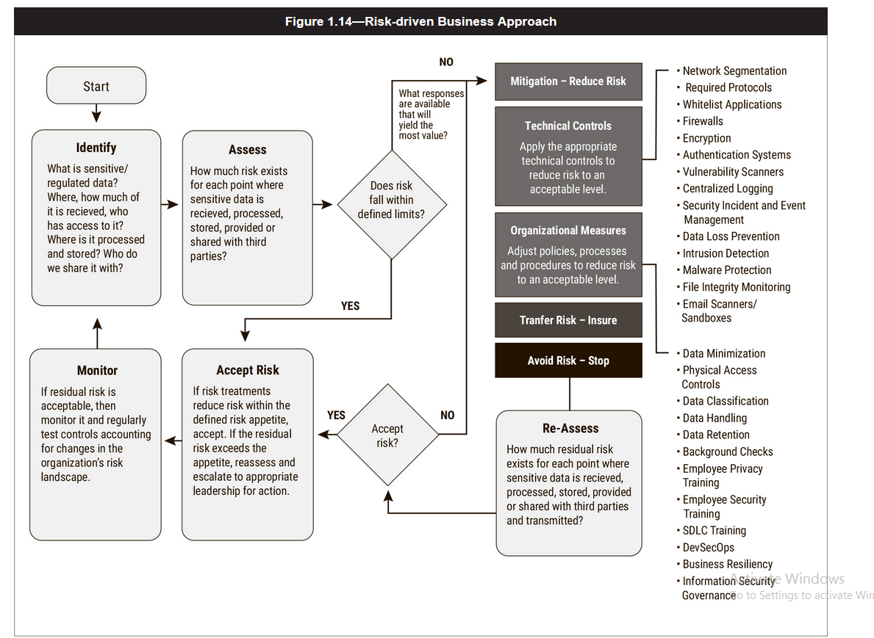
Figure 1.14 describes a sample approach for assessing risk associated with data loss.

Slide 12
The Value of Risk Communication
  Communication of the threats faced by the enterprise, incidents experienced, existing vulnerabilities and the business value of assets is an essential part of the risk-management process.
  Not every risk incident needs to be reported, but a lack of communication can be a sign that an enterprise is not healthy or stable.
  The discipline of risk management is related to audit, business continuity management and information security Management.
  Having a reporting relationship that facilitates communication regarding risk, threats, incidents, vulnerabilities and assets among these groups will result in a greater level of accuracy for the risk-management process.
  If managers are not open and transparent with regard to issues and operational failures, decisions may be made on the basis of incomplete or inaccurate information.
  The risk practitioner should seek to develop lines of communication and reporting so that information is available to management on a timely basis
  The method and openness of risk communications play a key role in defining the risk culture of the enterprise.
  Communication is important because it removes the uncertainty and doubts concerning risk management and supporting efforts.

Slide 13
If risk is to be effectively and efficiently managed and mitigated, it must first be openly discussed, properly communicated, and understood by the various stakeholders and personnel throughout the enterprise in ways that are appropriate for their respective roles.
The benefits of open communication of risk include:
    More informed risk decisions by the appropriate stakeholders due to an improved understanding of actual exposure and potential business impact
    Greater awareness among all stakeholders of the importance and value of integrating risk management into their daily duties
    Transparency to external stakeholders regarding both the actual levels of risk facing the enterprise and the risk-management processes in use
The consequences of poor communication on risk include:
    An overconfidence in the enterprise capabilities and controls pertaining to the risk universe
    false sense of security at all levels of the enterprise
    Improper categorization of risk
    Misallocation of resources
    Reduced value to the stakeholders

Slide 14
Unbalanced or ineffective communication of an organization risk to external stakeholders has the potential to lead to incorrect and negative perceptions by third parties, such as:
    Clients
    Investors
    Regulators
Ineffective communication can also give the perception that the organization is trying to hide risk from stakeholders.

Slide 15
Policies and Procedures
Importance of Policies and Procedures
Policies and procedures reflect management guidance and direction in developing controls over information systems, related resources and processes.
Policies
  Policies are high-level documents that represent the corporate philosophy of an organization.
  To be effective, policies must be clear and concise.
  Management must create a positive control environment by assuming responsibility for developing, documenting and controlling policies covering general goals and directives.
  In addition to corporate policies that set the tone for the organization as a whole, individual divisions and departments should define lower-level policies.
  To achieve strategic alignment, it is imperative that these divisional and departmental policies are consistent with corporate-level policies.
  Policies are one of the governance components .
  Good policies are effective, efficient, and nonintrusive (overlap).

Slide 16
information security policies as a set of policies.
Generally, the following policy concerns are addressed:
A high-level information security policy
  should include statements on confidentiality, integrity and availability.
  The primary information security policy is issued by the company to ensure that all employees who use information technology assets within the broadness of the organization, or its networks, comply with its stated rules and guidelines.
A data classification policy
  should describe the classifications,
  levels of control at each classification
  and responsibilities of all potential users including ownership.
An Employee Position Descriptions
  Define the role of every employee,
  including their level of responsibility,
  amount of authority for decision-making,
  overarching goals and specific tasks.
  Also create methods for monitoring performance and developing employees through training.
A Personnel Policies
  Clearly state business hours,
  terms of employment (hiring and termination),
  wages or salary (and bonuses, if any), insurance and health benefits,
  paid vs. unpaid vacation days, sick leave, and retirement.

Slide 17
A Safety Policy
  Use industry best practices and relevant local,
  state and federal laws as guidelines to create rules detailing what safe behavior at work looks like,
  how to use safety equipment,
  how to report safety hazards, etc.
A Technology Policy
  Establish what’s acceptable and what’s not in regards to Internet,
      email and social media usage for personal purposes at work.
A Disciplinary Action Policy
  Address issues of honesty, performance,
  safety and misconduct,
  and determine what constitutes a violation of company policy,
  as well as how employees will be disciplined if they violate certain rules.
Change Management Policy
  A change management policy refers to a formal process for making changes to IT, software development and security services/operations.
  The goal of a change management program is to increase the awareness and understanding of proposed changes across an organization,
  and to ensure that all changes are conducted methodically to minimize any adverse impact on services and customers.

Slide 18
Acceptable Use Policy (AUP)
  An AUP stipulates the constraints and practices that an employee using organizational IT assets must agree to in order to access to the corporate network or the internet.
  It is standard onboarding policy for new employees. They are given an AUP to read and sign before being granted a network .
  It is recommended that organizations IT, security, legal and HR departments discuss what is included in this policy.
Access Control Policy (ACP)
  The ACP outlines the access available to employees in regards to an organization’s data and information systems
  items covered in this policy are standards for user access, network access controls, operating system software controls and the complexity of corporate passwords.
Privacy Policy
    Protect employees, the company and your customers by establishing a policy that encourages transparency and trust with your customers.

Slide 19
Incident Response (IR) Policy
  The incident response policy is an organized approach to how the company will manage an incident and remediate the impact to operations.
  It’s the one policy CISOs hope to never have to use.
  However, the goal of this policy is to describe the process of handling an incident with respect to limiting the damage to business operations, customers and reducing recovery time and costs.
Remote Access Policy
  The remote access policy is a document which outlines and defines acceptable methods of remotely connecting to an organization's internal networks.
  this policy include rules for the use of BYOD assets.
  This policy is a requirement for organizations that have dispersed networks.
Email/Communication Policy
  A company's email policy is a document that is used to formally outline how employees can use the business’ chosen electronic communication medium.
  this policy could cover email, blogs, social media and chat technologies.
  The primary goal of this policy is to provide guidelines to employees on what is considered the acceptable and unacceptable use of any corporate communication technology.

Slide 20
A Organizational Structure
  Create a chart with each person’s name and title showing how each person fits into the structure of the organization.
Disaster Recovery Policy
  An organization’s disaster recovery plan will generally include both cybersecurity and IT teams’ input and will be developed as part of the larger business continuity plan.
  The CISO and teams will manage an incident through the incident response policy.
  If the event has a significant business impact, the Business Continuity Plan will be activated
Business Continuity Plan (BCP)
  The BCP will coordinate efforts across the organization and will use the disaster recovery plan to restore hardware, applications and data deemed essential for business continuity.
  BCP’s are unique to each business because they describe how the organization will operate in an emergency.

Slide 21
Risk Management Policy
  Like all policies the risk management policy must be subject to periodic review
  The organization’s risk appetite must be clearly articulated in the policy.
  The policy must also clearly define the roles and responsibilities for managing risks; often in large organizations there is a risk manager who oversees the risk management framework and processes.
  It is usual for each risk to have a named risk owner. The risk owner is responsible for the identification of the hazard, the evaluation and grading of the risk, and subsequent control measures.
  There needs to be in place a regular review process whereby each risk is reviewed to ensure that the control measures are effective and that the residual risk is correctly graded.
  The policy must set out the process, methods, and tools used to manage the risks within the organization.
  Typically this will comprise a risk matrix to grade the consequences and likelihood and then the recording of risks, traditionally by means of a risk register.
  There can be different levels of risk register, for example, at department level, and risks that cannot be managed at this level would sit on a higher level risk register at the division. Finally, there would be an organization risk register held by the board.

Slide 22
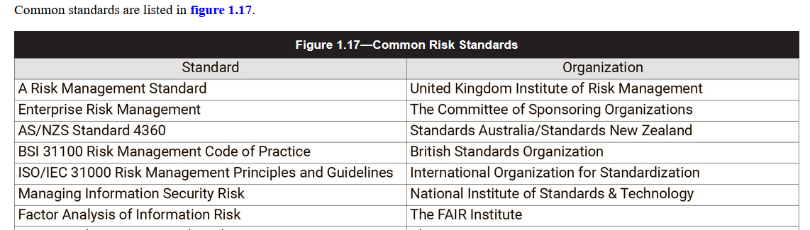
Standards
  A standard is a mandatory requirement, code of practice or specification approved by a recognized external standards organization, such as ISO.
  Standards are implemented to comply with the requirements and direction of policy to limit risk and support efficient business operations.
  An enterprise may base its practices and operations on external standards, such as an ISO standard, or it may develop and tailor its own standards, such as requiring all staff to use the same product, operating system or desktop.
  The use of a standard facilitates support and maintenance, provides better cost control and provides authority for the practices and procedures of the organization because a standard requires the implementation of certain practices.

Slide 23
Procedures
  Procedures are more granular than standards and support their implementation.
  A procedure is a document containing a detailed description of the steps necessary to perform specific operations in conformance with applicable standards.
  A lack of standards and procedures makes it difficult to carry out activities in a systematic manner and may result in undependable, inconsistent operations and elevated risk.
  The risk practitioner should also distinguish between the existence of published procedures and their actual use.
  It is common for procedures to be followed only for a short time, after which point experienced staff begin to work from memory.
  This practice should be discouraged in any environment in which precision is important, such as shutdown procedures for power plants or industrial machinery or complex monetary transactions.
  Specific to risk management efforts, Figure 1.18 lists common risk management procedures.

Slide 24
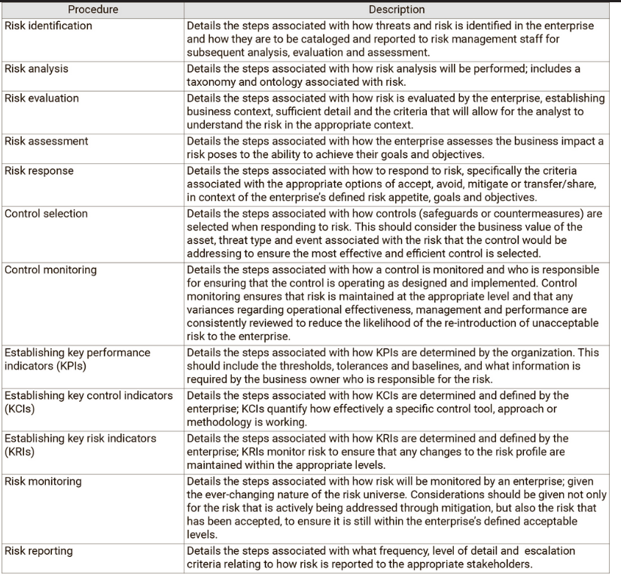

Slide 25
Exception Management
  Having policies, standards and procedures in place is an essential part of operating secure systems and attaining a secure state; however, there may be cases in which an exception to policy, standard or procedure is necessary.
  If exceptions are undocumented and uncontrolled, the level of risk is unknown and may result in an undesired level of risk
  Therefore, exceptions should only be allowed through a documented, formal process that requires approval of the exception by a senior manager.
  The risk practitioner must ensure that an exception management process is in place and is being followed, and that exceptions are removed when they are no longer needed.

Slide 26
Risk Management Standards and Frameworks
  Many risk management frameworks and standards have been published and should be leveraged because they provide definition and guidance for formulation and implementation of the enterprise risk management (ERM) framework.
  After a risk management framework is in place, a common approach can be used across the business, bringing together disparate risk disciplines and functions into a consolidated and consistent approach.
  There are a number of risk management frameworks and standards. They provide guidance for the application of risk management and have various origins.
  Some of the more popular ones include:
    ISACA’s Risk IT Framework
    COSO ERM Integrated Framework
    Factor Analysis of Information Risk (FAIR)
    ISO 31000 Risk Management series
    Project Management Body of Knowledge (PMBOK®)
    ISO/IEC 27005:2018: Information technology—Security techniques—Information security risk management
    ISO/IEC 27001:2013: Information technology—Security techniques—Information security management systems—Requirements
    ISO/MEC 27002:2013: Information technology—Security techniques—Code of practice for information security controls
  Note: The CRISC candidate will not be tested on any specific standard. The use of any standards in this review manual is for example and explanatory purposes only.

Slide 27
ISO 31000:2018 Risk Management Guidelines
  ISO 31000:2018 states:
  Organizations of all types and sizes face external and internal factors and influences that make it uncertain whether they will achieve their objectives.
  Managing risk is will assists organizations in setting strategy, achieving objectives and making informed decisions.
  Managing risk is part of governance and leadership and is fundamental to how the organization is managed at all levels.
  Managing risk is part of all activities associated with an organization and includes interaction with stakeholders.
  Managing risk considers the external and internal context of the organization, including human behavior and cultural factors.
  ISO 31000:2018 also describes three major components for risk management (Figure 1.19).

Slide 28
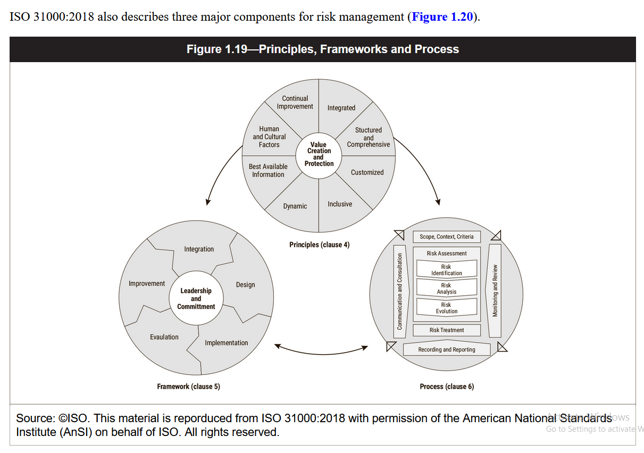
  ISO 31000:2018 also describes three major components for risk management (Figure 1.19).

Slide 29
Risk IT Framework
The ISACA Risk IT framework is intended to help implement risk governance and enhance IT-related risk management.
The Risk IT framework offers a structured, systematic methodology that enables enterprises to:
    Identify current and emerging risk throughout the extended enterprise
    Develop appropriate operational capabilities to ensure that business processes continue operating through adverse events
    Leverage investments in compliance or internal control systems already in place to optimize IT-related risk
    Raise awareness of the balance between the benefits of technology and external partners and the potential impacts of cyberthreats, internal control failures, and risk introduced by vendors, suppliers, and partners
    Focus internal and external risk management resources to maximize enterprise objectives

Slide 30
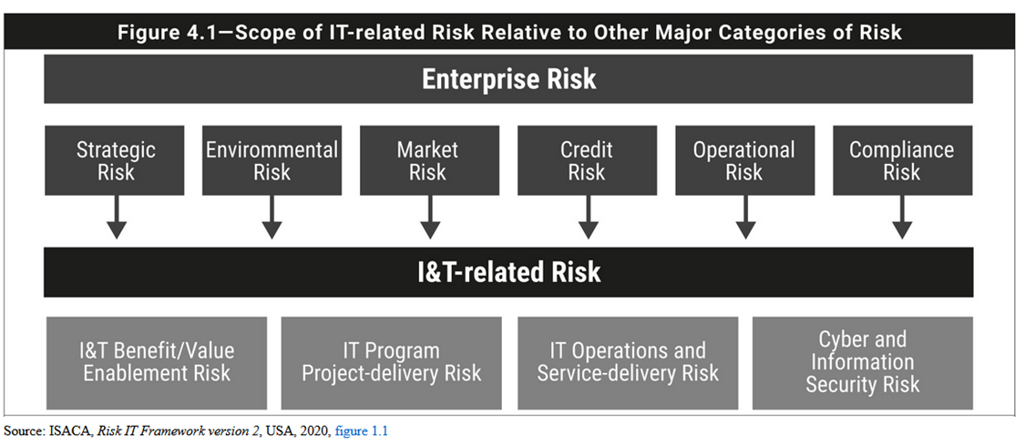
The Risk IT framework positions IT risk as a component of the overall risk universe of the enterprise.
It takes its place in the risk that an enterprise faces, which includes strategic risk, operational risk, compliance risk, credit risk, and market risk.
However, even strategic risk can have an IT component, especially when IT is the key enabler of new business initiatives.
The same applies for credit risk, especially when poor IT security can lead to lower credit ratings.
For this reason, the preferred depiction of IT risk is not within a hierarchic dependency on one of the other risk categories, but as a horizontal risk category applying to all other individual risk categories

Slide 31
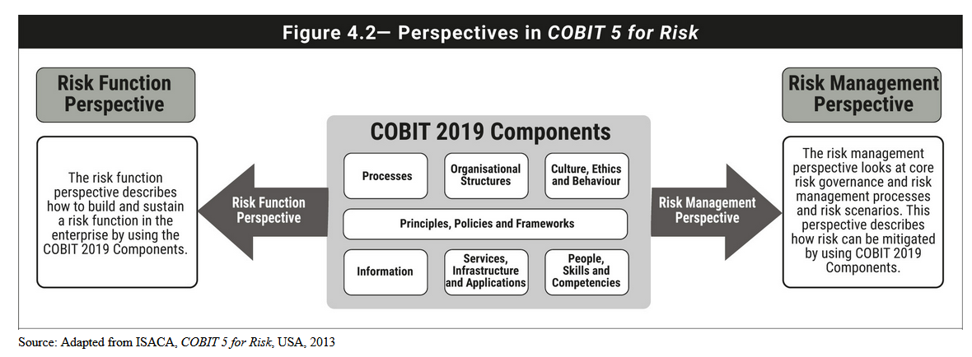
    COBIT 5 for Risk
COBIT 5 for Risk is an information risk view of COBIT and serves as the information risk-specific guidance as it relates to COBIT for the ISACA information risk professionals.
To provide context, enablers within COBIT 5 have now been transitioned to “components of a governance system” (components) in COBIT 2019.
COBIT 5 for Risk develops two different perspectives in which practical guidance is provided:
    The risk function perspective—How to build and sustain a risk management function leveraging the COBIT 2019 components
    The risk management perspective—How to mitigate risk using the COBIT 2019 components

Slide 32
ISO 31000:2018 Principles and Guidelines on Implementation of Risk Management
The ISO 31000 is a family of standards related to risk management.
ISO 31000:2018—Risk Management—Guidelines is applicable throughout the life of an enterprise and to a wide range of activities, processes, functions, projects, products, services, assets, operations, and decisions.
Clause 4 prescribes a number of principles to be adhered to for the effectiveness of an organization’s risk management

Slide 33
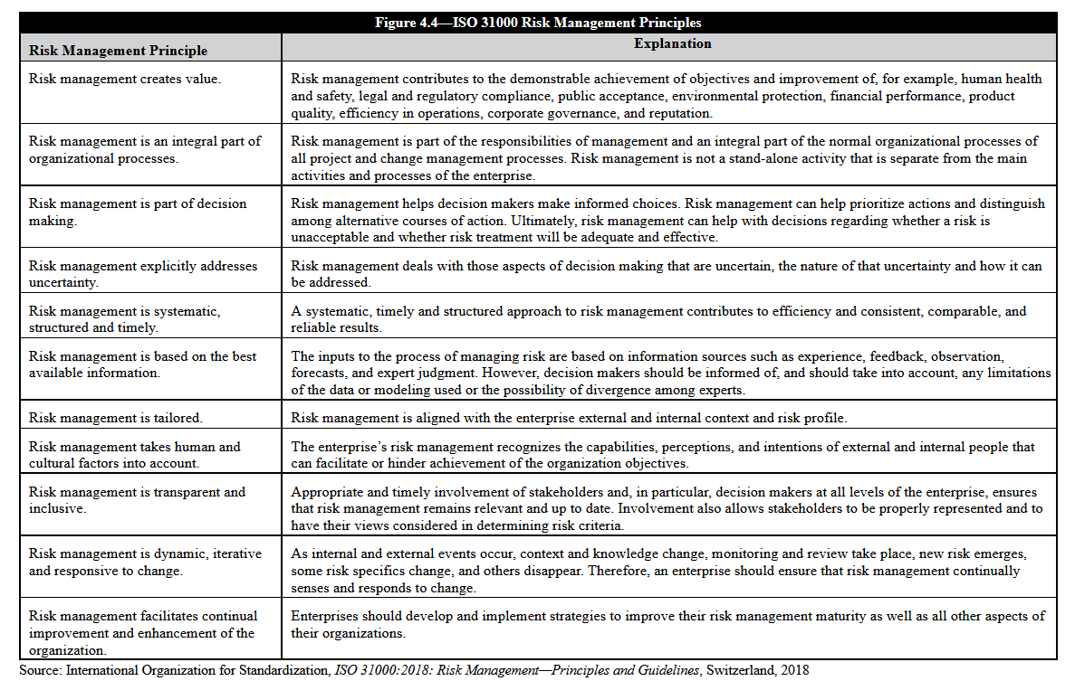

Slide 34
Clause 6 of the standard outlines processes for managing risk.
The standard states that the risk management process should be an integral part of management, and embedded in culture and practices, and tailored to the business processes of the enterprise.
The risk management process includes five activities:
    Communication and consultation
    Establishing the context
    Risk assessment
    Risk treatment
    Monitoring and review
The objective of the standard is to provide guidance to enable public, private, or community enterprises, groups, and individuals to achieve the following:
    A more confident and rigorous basis for decision making and planning
    Better identification of opportunities and threats
    Gaining value from uncertainty and variability
    Proactive, rather than reactive, management
    More effective allocation and use of resources
    Improved incident management and reduction in loss and the cost of risk
    Improved stakeholder confidence and trust
    Improved compliance with relevant legislation
    Better corporate governance

Slide 35
OCTAVE and OCTAVE-S
The Operationally Critical Threat, Asset, and Vulnerability Evaluation (OCTAVE) is a framework for identifying and managing information security risks.
OCTAVE was developed in 2001 at Carnegie Mellon University (CMU), for the United States Department of Defense.
OCTAVE designed for organizations with at least 300 employees
OCTAVE is flexible and allows an organization to tailor its use based upon its own assessment needs, the methodology is performed as three sequential phases.
  The first phase: identifying assets, threats, protection practices, vulnerabilities, and security requirements.
  The second phase: the members of the workshop perform assessment activities and evaluate the infrastructure.
  The third phase: the workshop members develop response strategies for the identified risks.
OCTAVE-S is fundamentally the same as the original OCTAVE, Except:
  it was designed to assess smaller
organizations, (fewer than 100 people).
  Relies more on internal personnel with extensive knowledge of the organization and its infrastructure and less on outside risk experts or facilitators.
  The number of workshop members considerably less; the team may rely on fewer than ten key experts in the organization.
  Processes and procedure documents include more detailed security-related information

Slide 36
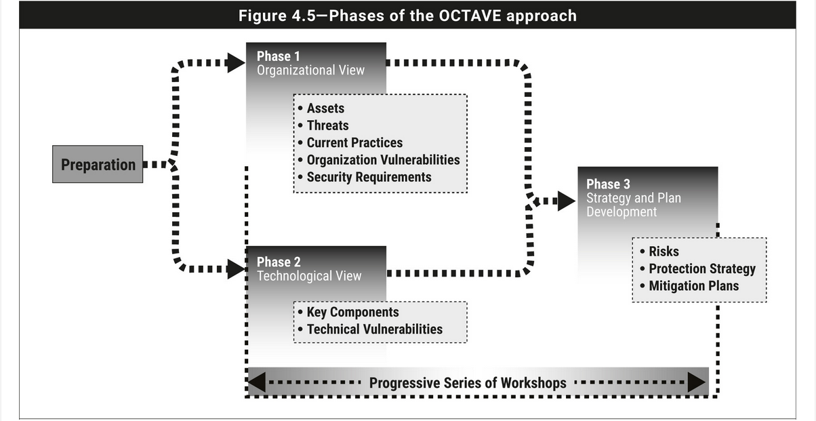
  Phase 1: Build Asset-Based Threat Profiles
  Phase 2: Identify Infrastructure Vulnerabilities
  Phase 3: Develop Security Strategy and Plans

Slide 37
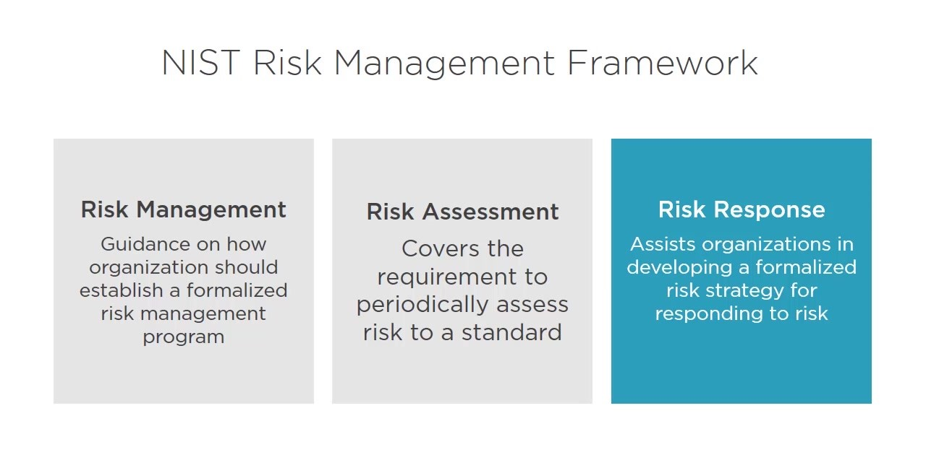

Slide 38
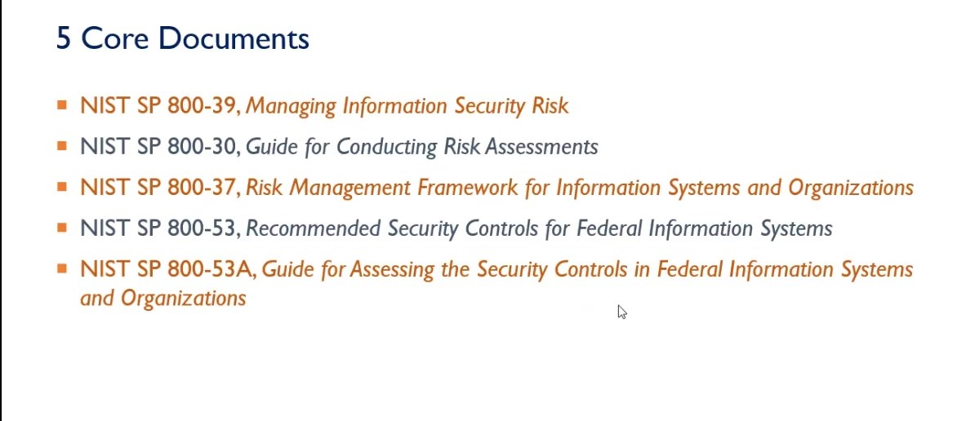

Slide 39
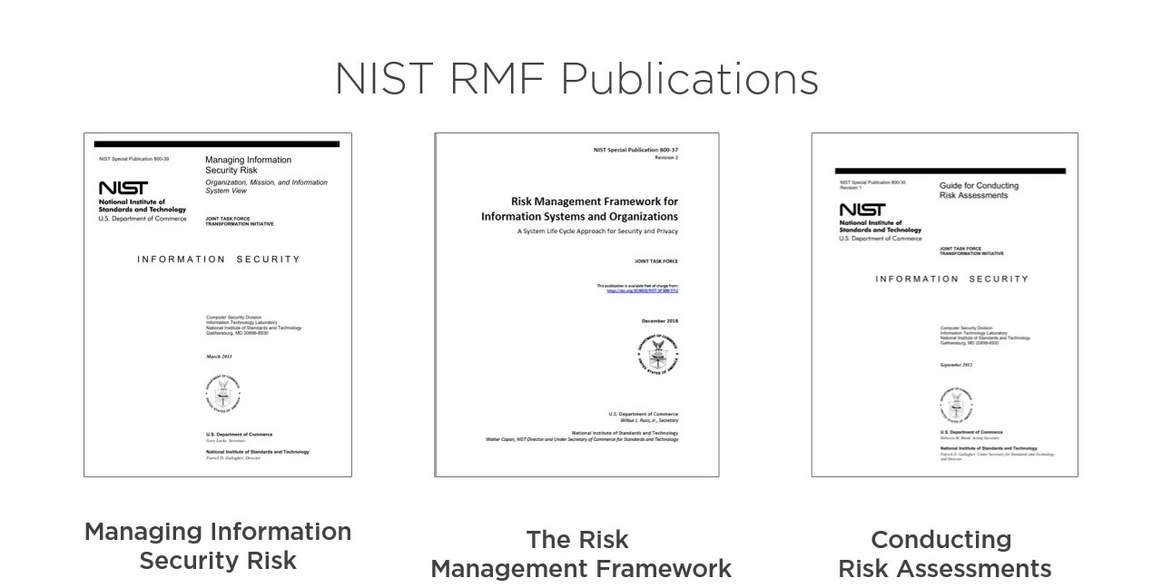

Slide 40
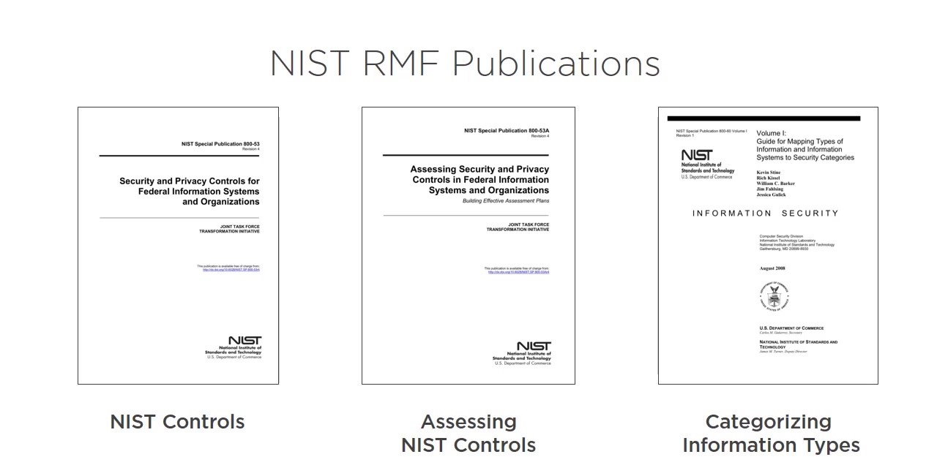

Slide 41
NIST RMF
Step 1: Prepare for
assessment.
Step 2: Conduct assessment.
Step 3: Communicate results.
Step 4: Maintain assessment.
a. Identify threat sources
and events.
Describes an overall risk management process that covers all aspects of the risk life cycle.
NIST uses a four step risk assessment process found in Special Publication 800-30, “Guide for Conducting Risk Assessments.”
b. Identify vulnerabilities
and predisposing conditions.
c. Determine likelihood of occurrence.
d. Determine magnitude of impact.
e. Determine risk.

Slide 42

One of the most widely used risk management frameworks was developed by the National Institute of Standards and Technology, a US federal government agency.
The NIST process is mandatory for many government computer systems, but private organizations have also widely adopted it because they find it a helpful approach.
The framework is found in NIST Special Publication 800-37.
an overview of the six steps in the process will be more than enough to prepare for the exam.

Slide 43
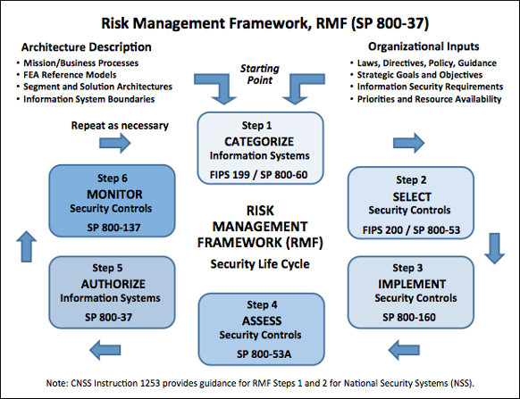

Slide 44
Example of a Risk Management Program Based on ISO/IEC 27005
in cases where good risk management practices are not currently in place, the risk practitioner may wish to formally adopt or informally use one or more standard or framework to guide his/her risk management program.
Risk management includes several components, first identify areas of risk and analyze them, then use the results of these analyses to choose appropriate ways of responding to them, after which the organization monitors the effectiveness of its implemented choices and reports progress to senior management.
Figure 1.20 illustrates one such program based on ISO/IEC 27005:2011.
Note: The following is provided as an example of a risk-management process.
The risk practitioner may find that they will need to adopt one or more well-established standards or frameworks to ensure that the risk management program in their organization is complete and authoritative.

Slide 45
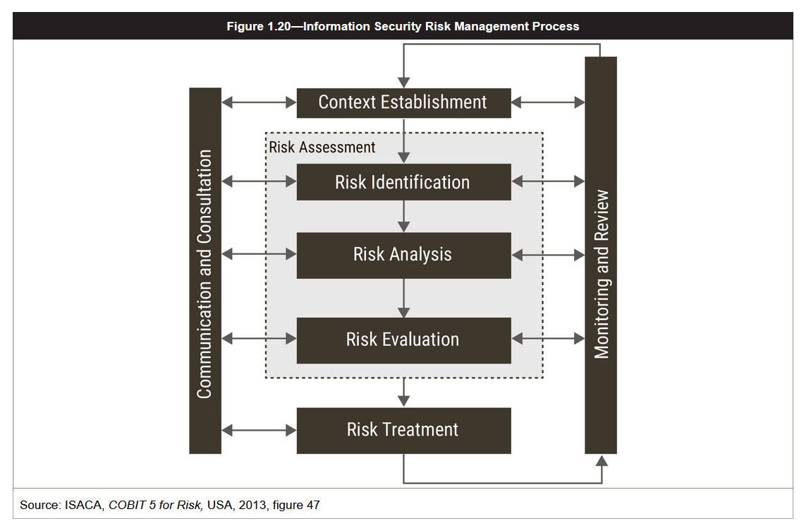

Slide 46
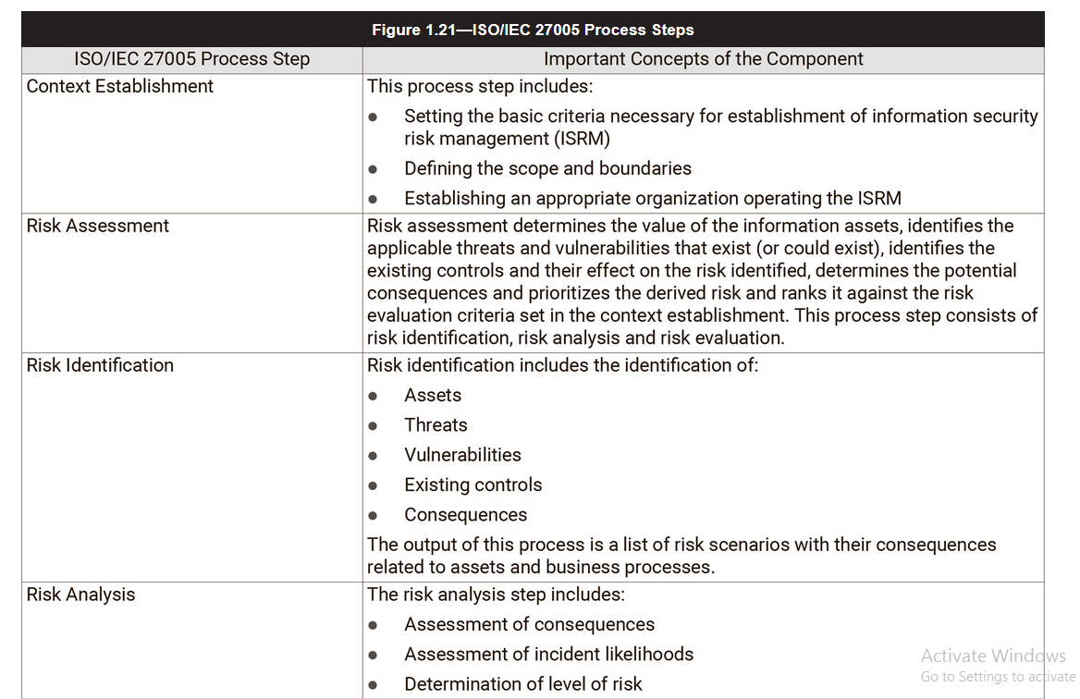

Slide 47
